Slide 1
Mobile-Cloud Computing-Based Assistive Technologies for the Blind

Slide 2
Useful Information
Bharat Bhargava, Professor of Computer Science, Purdue University, West Lafayette, In 47907
www.cs.purdue.edu/homes/bb
https://www.cs.purdue.edu/homes/bb/#colloquia
https://www.cs.purdue.edu/homes/bb/cloud.html
https://www.cs.purdue.edu/homes/bb/cs590/
CS 590: Cloud Systems for Blind and Hearing Impaired

Slide 3
The Navigation Problem
Indoor and outdoor navigation is becoming a harder task for blind and visually impaired people in the increasingly complex urban world
Advances in technology are causing the blind to fall behind, sometimes even putting their lives at risk
Technology available for context-aware navigation of the blind is not sufficiently accessible; some devices rely heavily on infrastructural requirements

Slide 4
Demographics
314 million visually impaired people in the world today
45 million blind
More than 82% of the visually impaired population is age 50 or older
The old population forms a group with diverse range of abilities
The disabled are seldom seen using the street alone or public transportation

Slide 5
Goals
***Make a difference***
Bring mobile technology in the daily lives of blind and visually impaired people to help achieve a higher standard of life
Take a major step in context-aware navigation of the blind and visually impaired
Bridge the gap between the needs and available technology
Guide users in a non-overwhelming way
Protect user privacy

Slide 6
Challenges
Real-time guidance
Portability
Power limitations
Appropriate interface
Privacy preservation
Continuous availability
No dependence on infrastructure
Low-cost solution
Minimal training

Slide 7
Discussions
Cary Supalo: Founder of Independence Science LLC (http://www.independencescience.com/)
T.V. Raman: Researcher at Google, leader of Eyes-Free project (speech enabled Android applications)
American Council of the Blind of Indiana State Convention, 31 October 2009
Miami Lighthouse Organization

Slide 8
Mobility Requirements
Being able to avoid obstacles
Walking in the right direction
Safely crossing the road
Knowing when you have reached a destination
Knowing which is the right bus/train
Knowing when to get off the bus/train
All require SIGHT as primary sense

Slide 9
What needs to be done?
Provide fully context-aware and safe outdoor navigation to the blind user:
Provide a solution that does not require any infrastructure modifications
Provide a near-universal solution (working no matter what city or country the user is in)
Provide a real-time solution
Provide a lightweight solution
Provide the appropriate interface for the blind user
Provide a highly available solution
Notes:
Here are some requirements of a real and widely applicable solution, to the problem of providing fully context-aware and safe outdoor navigation for the blind people. The system developed for this purpose should not require any modifications to the existing infrastructure, as in the case of accessible pedestrian signals. The solution should be universally applicable, for example, it should be able to guide the user whether he is in India or the US. The solution should of course be compliant with the real-time requirements of the problem, as for an application like pedestrian crossing guidance, timeliness of response is critical. The device should not be too heavy to carry around the whole day and should provide an interface that would not obstruct the user’s attention to the environment. The solution should also be highly available, i.e. little to no interruption in service should be experienced by the user.

Slide 10
Context-Aware Navigation Components
Outdoor Navigation (finding curbs -including in snow, using public transportation, interpreting traffic patterns/signal lights…)
Indoor Navigation (finding stairs/elevator, specific offices, restrooms in unfamiliar buildings, finding the cheapest TV at a store…)
Obstacle Avoidance (both overhanging and low obstacles…)
Object Recognition (being able to reach objects needed, recognizing people who are in the immediate neighborhood…)

Slide 11
Existing Blind Navigation Aids – Outdoor Navigation
Loadstone GPS (http://www.loadstone-gps.com/)
Wayfinder Access (http://www.wayfinderaccess.com/)
BrailleNote GPS (www.humanware.com)
Trekker (www.humanware.com)
StreetTalk (www.freedomscientific.com)
DRISHTI [1]
…

Slide 12
Existing Blind Navigation Aids – Indoor Navigation
InfoGrid (based on RFID) [2]
Jerusalem College of Technology system (based on local infrared beams) [3]
Talking Signs (www.talkingsigns.com) (audio signals sent by invisible infrared light beams)
SWAN (audio interface guiding user along path, announcing important features) [4]
ShopTalk (for grocery shopping) [5]

Slide 13
Existing Blind Navigation Aids – Obstacle Avoidance
RADAR/LIDAR
Kay’s Sonic glasses (audio for 3D representation of environment) (www.batforblind.co.nz)
Sonic Pathfinder (www.sonicpathfinder.org) (notes of musical scale to warn of obstacles)
MiniGuide (www.gdp-research.com.au/) (vibration to indicate object distance)
VOICE (www.seeingwithsound.com) (images into sounds heard from 3D auditory display)
Tactile tongue display [6]
…

Slide 14
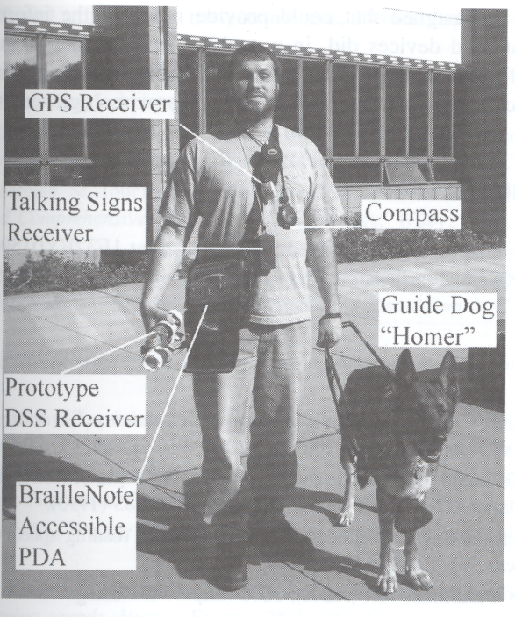
Putting all together…
Gill, J. Assistive Devices for People with Visual Impairments.
In A. Helal, M. Mokhtari and B. Abdulrazak, ed., The Engineering Handbook of Smart Technology for Aging, Disability and Independence.
John Wiley & Sons, Hoboken, New Jersey, 2008.

Slide 15
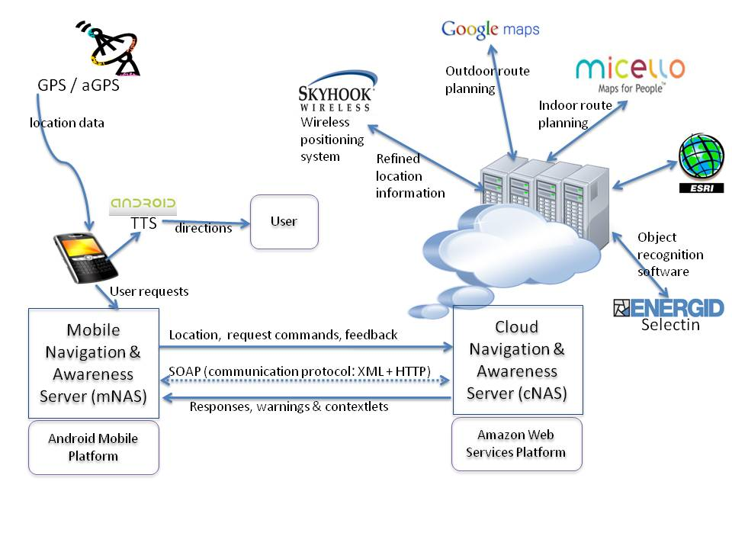
Mobile-Cloud System Architecture

Slide 16
Mobile-Cloud System Architecture
Services:
Google Maps (outdoor navigation, pedestrian mode)
Micello (indoor location-based service for mobile devices)
Object recognition (Selectin software etc)
Traffic assistance
Obstacle avoidance (Time-of-flight camera technology)
Speech interface (Android text-to-speech + speech recognition servers)
Remote vision
Obstacle minimized route planning

Slide 17
Advantages of a Mobile-Cloud Collaborative Approach
Open architecture
Extensibility
Computational power
Battery life
Light weight
Wealth of context-relevant information resources
Interface options
Minimal reliance on infrastructural requirements

Slide 18
Traffic Lights Status Detection Problem
Ability to detect status of traffic lights accurately is an important aspect of safe navigation
Color blind
Autonomous ground vehicles
Careless drivers
Inherent difficulty: Fast image processing required for locating and detecting the lights status → demanding in terms of computational resources
Mobile devices with limited resources fall short alone

Slide 19
Attempts to Solve the Traffic Lights Detection Problem
Kim et al: Digital camera + portable PC analyzing video frames captured by the camera [7]
Charette et al: 2.9 GHz desktop computer to process video frames in real time[8]
Ess et al: Detect generic moving objects with 400 ms video processing time on dual core 2.66 GHz computer[9]
Sacrifice portability for real-time, accurate detection

Slide 20
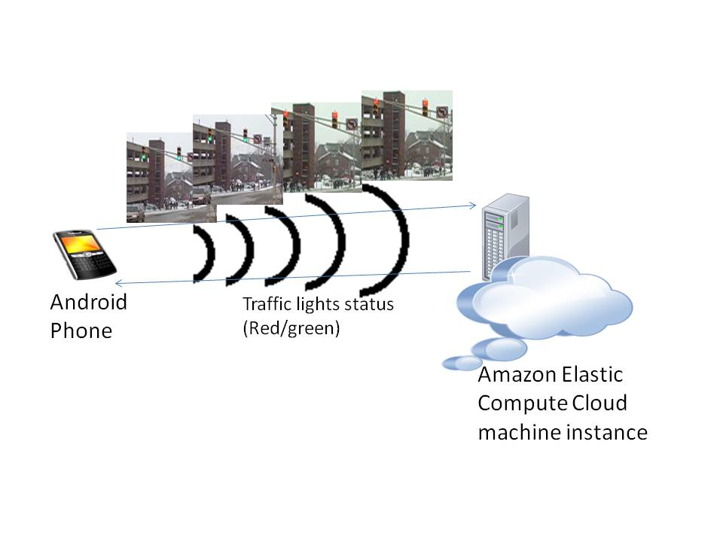
Mobile-Cloud Collaborative Traffic Lights Detector

Slide 21
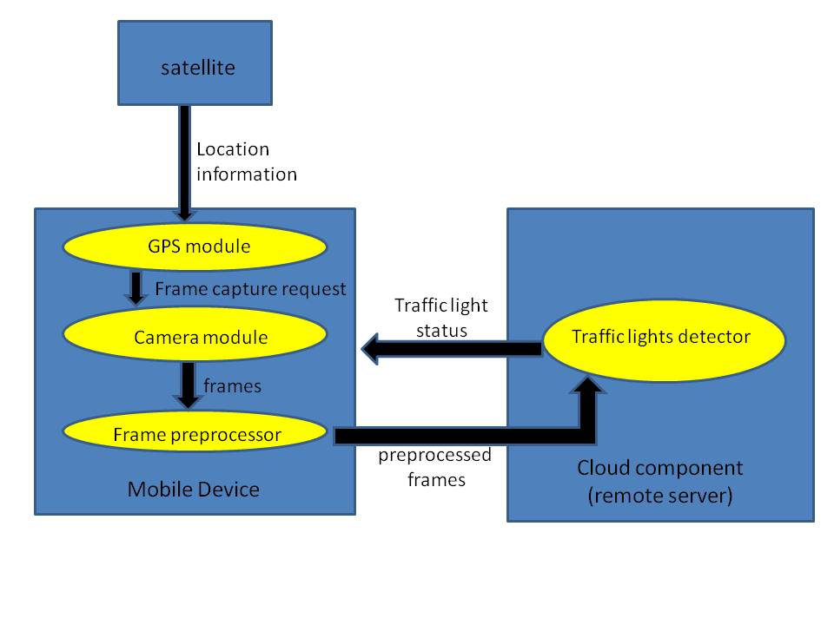
Enhanced Detection Schema

Slide 22
System Components
Android application: Extension to Google’s navigation application to integrate automatic photo capture at intersections
Compass: Use of the compass on Android device to ensure correct positioning of the user
Camera: Camera module on eye glasses communicating with the device via Bluetooth or devices like Google Glass can be used
Crossing guidance algorithm: Multi-cue image processing algorithm in Java running on Amazon EC2
Notes:
Here are the basic components of the proposed system:
We extended an open source navigation application named WalkyTalky by the Eyes-free group at Google, which navigates the user to his destination using GPS and Google Maps, and we integrated crossing guidance to this application. The automatic image capturing function was also added to the application.
In order to make the detection more accurate, we enabled the Compass function in the application. The reason for using the Compass function is obtaining the heading direction of the blind user to correctly position him at the intersection.
During the implementation of the current system, the native Android camera was used to take the pictures at street intersections. However, in future work we will be employing camera modules integrated into glasses worn by the user. This is considering the fact that the placement of the camera is of vital importance, for collection of context-relevant data, and an eye-level placement is the most natural. We are also considering the placement of camera modules on the sides of the glasses for even better context-awareness.
The Elastic Compute Cloud service of Amazon Web Services was used to host the cloud component of our system, where the server receives video frames from the Android mobile device, processes to detect the presence and status of pedestrian signals in the frame, and sends a response back to the mobile device over a TCP connection. We chose to use the Amazon platform in this project, due to its proven robustness and ease of use.

Slide 23
Adaboost Object Detector
Adaboost: Adaptive Machine Learning algorithm used commonly in real-time object recognition
Based on rounds of calls to weak classifiers to focus more on incorrectly classified samples at each stage
Traffic lights detector: trained on 219 images of traffic lights (Google Images)
OpenCV library implementation

Slide 24
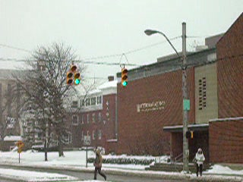
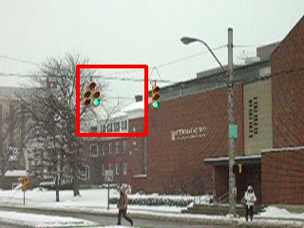
Experiments: Detector Output

Slide 25
Experiments: Response time

Slide 26
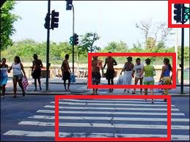
Multi-cue Signal Detection Algorithm: A Conservative Approach
Ref: http://news.bbc.co.uk
Notes:
We are currently investigating the effectiveness of a multi-cue algorithm, in providing accurate guidance to the user at intersections. As seen in the figure here, the presence of contextual clues including other pedestrians crossing in the same direction, a zebra crossing and the status of traffic lights in the same direction, provide additional information to make an accurate decision about whether the user should cross. With the help of Cloud Computing, we will be able to run all of these detection algorithms in parallel to make a more informed and conservative decision at the crossing. Another important aspect we will take into consideration in the development of the detection algorithm is the universal aspects of pedestrian signals. As signals in different countries and even different cities can be dramatically different from each other, it will be important to focus on the common features at the image processing stage, instead of training the detector with a dataset of signal images, which may not be comprehensive.

Slide 27
Accessible Classroom Technologies
The rigid classroom structure does not provide sufficient resources necessary to meet reading, writing, science and math learning needs of students with disabilities
Lack of assistive classroom technologies cause students with disabilities to fall behind in education
There is need for integrated assistive classroom technologies

Slide 28
Existing Assistive Technologies
Talking calculators
Electronic worksheets
Word prediction software
Text-to-speech software (screen readers)
Personal FM systems
Digital pens
Variable speed recorders
Abbreviation expanders

Slide 29
Existing Assistive Technologies (cont.)
Portable word processors
Alternative keyboards
Speech recognition
Optical character recognition
Communication access real-time translation
Audiobooks
Low-tech solutions

Slide 30
Problems with Existing Assistive Classroom Technologies
Lack of standardization
Need for special infrastructure
No all-in-one solutions
High price for some technologies
Lack of widespread technical support due to specialization
Training requirements

Slide 31
Need for Integrated Classroom Accessibility Technologies
Using same tool to address multiple problems:
Visual impairments
Hearing impairments
Learning disabilities
Easy-to-use tool for both students and teachers
Common off-the-shelf technologies for widespread adoption

Slide 32
System Architecture Vision
Tablets as the mobile component
Course software client with multiple interfaces
Cloud servers
Data integration
Real-time processing of computationally-intensive tasks
Teaching software
Connected to cloud for real-time tracking of presentation
Offline editing of course data in cloud servers

Slide 33
Envisioned System Capabilities
Text-to-speech
Real-time captioning
Collaborative note-taking
OCR
Presentation tracking
Real-time lecture recording
Offline editing

Slide 34
Other Applications: Face Recognition
To enable identification of people in the immediate surroundings
Uses a mobile device to captures an image
Image is sent to the cloud for processing
Picture sent to the cloud is compared to each image in a database stored in the cloud for matching
Facial expression analysis also possible

Slide 35
Other Applications: Dollar Bill Identification
Android app to identify US dollar bills
Components: client application on the smartphone, an image database of US dollar bills currently in circulation and server application on the Amazon cloud
Image of currency captured with camera, send to the cloud for processing
Text value of dollar bill sent to device, converted to speech by Android text-to-speech interface

Slide 36
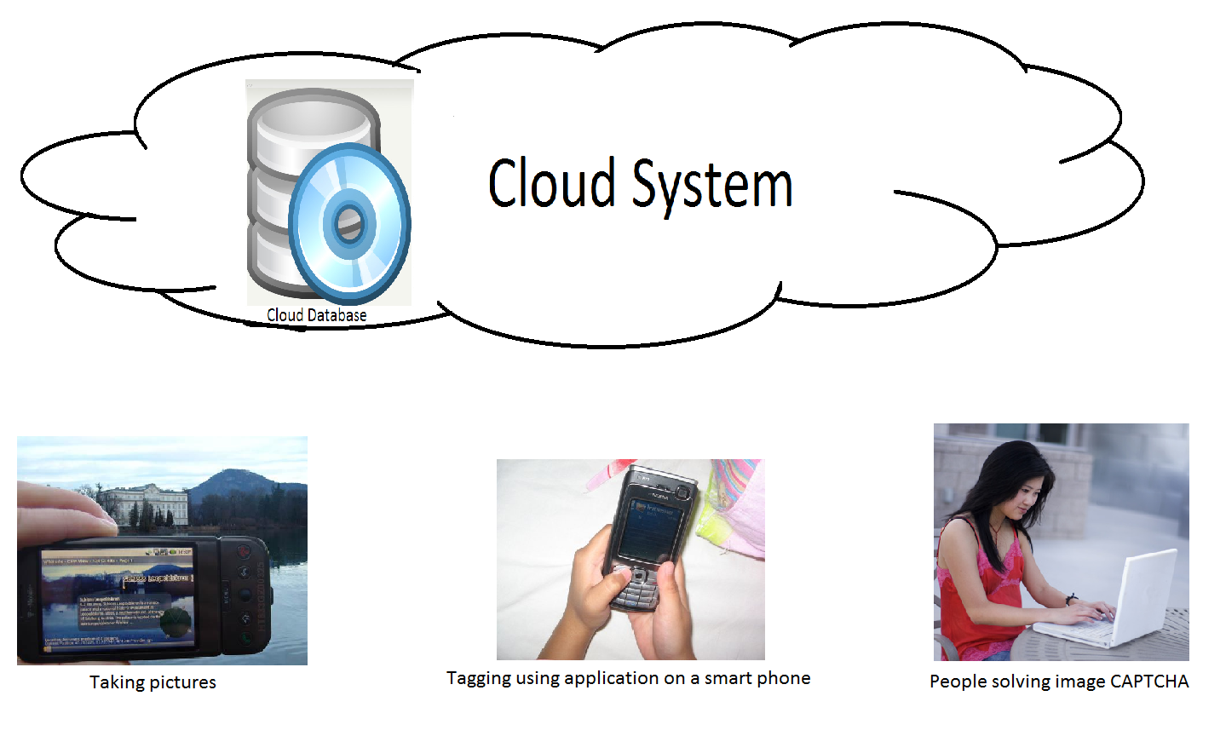
Other Applications: Object recognition: humans + cloud

Slide 37
References
L. Ran, A. Helal, and S. Moore, “Drishti: An Integrated Indoor/Outdoor Blind Navigation System and Service,” 2nd IEEE Pervasive Computing Conference (PerCom 04).
S.Willis, and A. Helal, “RFID Information Grid and Wearable Computing Solution to the Problem of Wayfinding for the Blind User in a Campus Environment,” IEEE International Symposium on Wearable Computers (ISWC 05).
Y. Sonnenblick. “An Indoor Navigation System for Blind Individuals,” Proceedings of the 13th Annual Conference on Technology and Persons with Disabilities, 1998.
J. Wilson, B. N. Walker, J. Lindsay, C. Cambias, F. Dellaert. “SWAN: System for Wearable Audio Navigation,” 11th IEEE International Symposium on Wearable Computers, 2007.
J. Nicholson, V. Kulyukin, D. Coster, “ShopTalk: Independent Blind Shopping Through Verbal Route Directions and Barcode Scans,” The Open Rehabilitation Journal, vol. 2, 2009, pp. 11-23.
Bach-y-Rita, P., M.E. Tyler and K.A. Kaczmarek. “Seeing with the Brain,” International Journal of Human-Computer Interaction, vol 15, issue 2, 2003, pp 285-295.
Y.K. Kim, K.W. Kim, and X.Yang, “Real Time Traffic Light Recognition System for Color Vision Deficiencies,” IEEE International Conference on Mechatronics and Automation (ICMA 07).
R. Charette, and F. Nashashibi, “Real Time Visual Traffic Lights Recognition Based on Spot Light Detection and Adaptive Traffic Lights Templates,” World Congress and Exhibition on Intelligent Transport Systems and Services (ITS 09).
A.Ess, B. Leibe, K. Schindler, and L. van Gool, “Moving Obstacle Detection in Highly Dynamic Scenes,” IEEE International Conference on Robotics and Automation (ICRA 09).
P. Angin, B. Bhargava, R. Ranchal, N. Singh, L. Lilien, L. B. Othmane, “A User-centric Approach for Privacy and Identity Management in Cloud Computing,” , SRDS 2010.

